Slide 1
No sql

Slide 2
Defining NoSQL
In computing,
NoSQL (mostly interpreted as "not only SQL")
is a broad class of database management systems
identified by
its non-adherence to the widely used
relational database management system model;
that is, NoSQL databases are
not primarily built on tables,
and as a result,
generally do not use SQL for data manipulation.

Slide 3
What is NoSQL
Does not use Traditional RDBMS model
Data is non-relational
It does not use SQL as the query language.
NoSQL is not a database. It is not even a type of database.
NoSQL is not a database. It is not even a type of database

Slide 4
ACID property for traditional Rdbms
Atomicity: Everything in a transaction succeeds lest it is rolled back.
Consistency: A transaction cannot leave the database in an inconsistent state.
Isolation: One transaction cannot interfere with another.
Durability: A completed transaction persists, even after applications restart.
BASE (coined by Eric Brewer)
Basic availability: Each request is guaranteed a response—successful or failed execution.
Soft state: The state of the system may change over time, at times without any input (for eventual consistency).
Eventual consistency: The database may be momentarily inconsistent but will be consistent eventually.

Slide 5
Why NoSQL?
Schemaless data representation:
Almost all NoSQL implementations offer schemaless data representation. This means that you don’t have to think too far ahead to define a structure for inserting new field or nesting of data.
Development time
It reduce the development time, as no SQL is required and join query required.
Speed:
It is much faster to execute.

Slide 6
List of NO SQL Database
Document base
Mongodb,couchdb,terrastore
Key –value pair
Redis,membase,Voldemort,memchache db
XML
baseX,eXist
Graph
Node4j,flockdb,
Column based
Hadoop,Cassendra

Slide 7
RDBMS Approach
Identify actors
Define Models
Define entities
Define relationships
Program Database and application
Iterate
Technical Requirement for RDBMS
Schema flexibility : RDBMS are quite inflexible in their design. Adding a single column will add much complexity.
Complex queries: required a complex query if multiple tables are required to join
Data update : Updating data across multiple tables is probably one of the more complex scenarios if single data may affect multiple tables other field.

Slide 8
Scalability : its become a complex task to scale the system in RDBMS.

Slide 9
NO SQL approach
NoSQL-based solutions provide answers to most of the challenge that is come in RDBMS
Schema flexibility:
It does not have schema like RDBMS it is schema less.
Allows flexibility of adding one or more columns as required, on the fly.
Document based database(mongoDB) allow storing semi structured data.
Complex query
It does not have foreignkey .It does not have complex query, No join query

Slide 10
Data update:
In RDBMS synchronization is more difficult when data update is performed.
NoSQL is providing great synchronization.
Scalability:
NoSQL solutions provider greater scalability for obvious reasons. AS it does not have table schema, no join query across multiple tables.
In NoSQL what ever data required can put together. No concept data across multiple tables.
Data can be stored in single document

Slide 11
No SQL storage type
The NoSQL databases are categorized on the basis of how the data is stored. Because of the need to provide curated information from large volumes, generally in near real-time
Different type of storage type
Column –oriented :
Data stored in column form.
column-oriented database stores data as columns

Slide 12
Data stored in internal form like
In RDBMS data stored in
SM1,Anuj,Sharma,45,10000000
MM2,Anand,,34,5000000
T3,Vikas,Gupta,39,7500000
E4,Dinesh,Verma,32,2000000
However, in column-oriented databases, the data will be stored internally as follows:
SM1,MM2,T3,E4
Anuj,Anand,Vikas,Dinesh
Sharma,,Gupta,Verma,
45,34,39,32
10000000,5000000,7500000,2000000

Slide 13
Advantage
Apache Cassandra, HBase, and Google Datastore, allow adding columns over time without having to worry about filling in default values/datatype in the existing rows for the new columns.
There are advantages when working with a subset of the available columns. For example, computing maxima, minima, averages and sums, specifically on large datasets, is where these column-oriented data stores outshine in performance

Slide 14
Document
referred to as document-oriented database, a document store allows the inserting, retrieving, and manipulating of semi-structured data.
most of the databases available under this category use XML, JSON, BSON, or YAML,
compared to RDBMS, the documents themselves act as records (or rows)
It does not follow the strict schema like a RDBMS
Even though the documents do not follow a strict schema, indexes can be created and queried.

Slide 15
For e.g one document may it contain information about employee
{ empid: “1234”, “
“firstname” : “abc”,
“lastname” : “xyz”
}
Anthor document may contains more information about employee
{ empid: “1234”,
“firstname” : “ccc”
“lastname” : “sss”
“salary” : “16000 “, “department” : “sales”,
} second document having more detail than first. And may be third document contains information about department so it can be easily handled in schemaless

Slide 16
Document-oriented databases flexibility for dynamic or changeable schema or even schemaless documents.
Advantage
As content is schema less This is very useful in web-based applications where there is a need for storing different types of content that may evolve over time
Some of popular databases that provide document-oriented storage include:
• MongoDB • CouchDB • Jackrabbit • Lotus Notes • Apache Cassandra

Slide 17
Advantage
content is schemaless, This is very useful in web-based applications where there is a need for storing different types of content.
For example, for a grocery store, information about the users, inventory and orders can be stored as simple JSON or XML documents.
XML based document gives good supports for multiple web application.
CouchDB provides a RESTful HTTP interface with the standard HTTP methods

Slide 18
Key-value pair
A Key-value store is very closely related to a document store—
No schema
it allows the storage of a value against a key. Similar to a document store, there is no need for a schema to be enforced on the value
Key value needs to create, only new key-value pair to insert new data
few of the popular key value stores are:
• Redis , MemcacheDB ,• Berkley DB
Advantage
Key-value stores are optimized for querying against keys. they serve great in-memory caches.

Slide 19
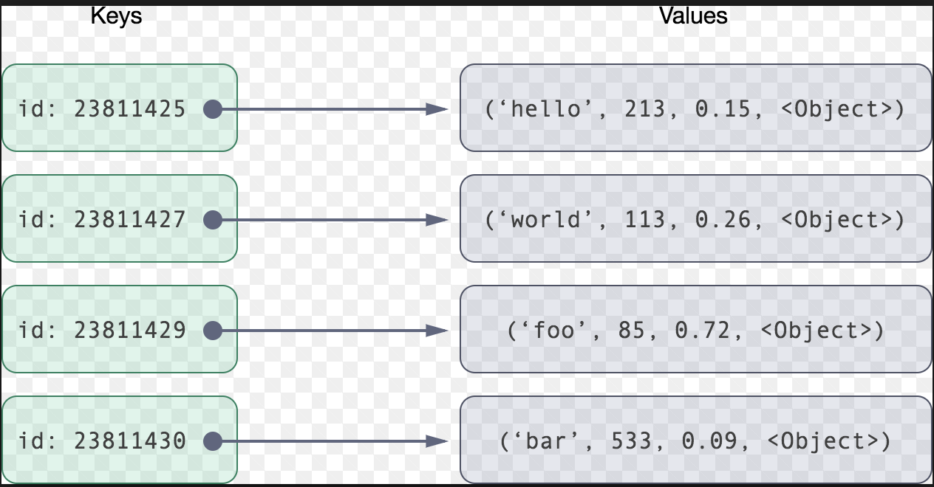
the key-value stores cannot query on the values, they can still understand the type of value

Slide 20
Graph store
Graph databases represent a special category of NoSQL databases where relationships are represented as graphs.
There can be multiple links between two nodes in a graph—representing the multiple relationships that the two nodes share.
The relationships represented may include social relationships between people, transport links between places,
Neo4j• FlockDB (from Twitter)

Slide 21
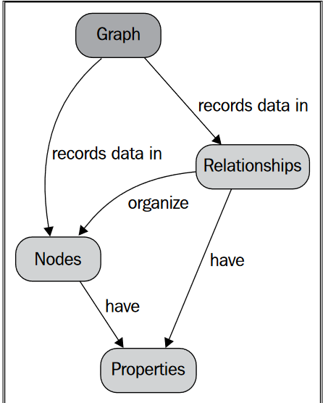
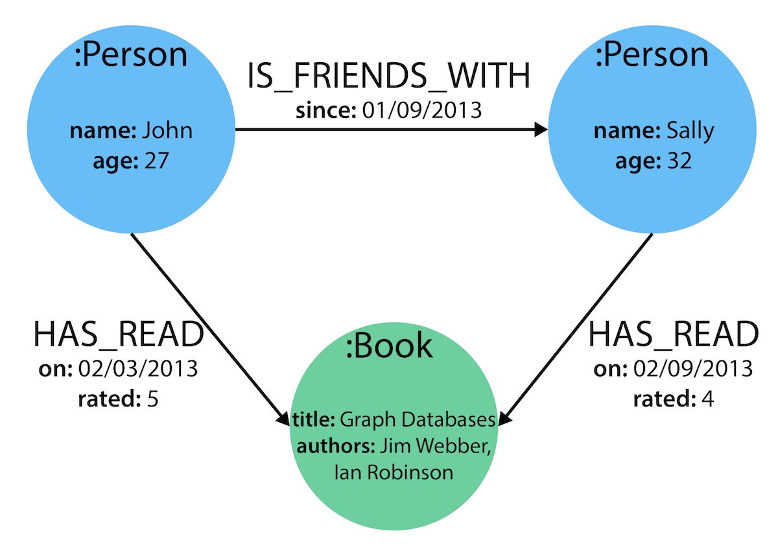

Slide 22
Advantage
Graph databases can be considered as special purpose NoSQL databases optimized for relation-heavy data.
The one advantage that graph databases have is easy representation, retrieval and manipulation of relationships between the entities in the system

Slide 23
Comparing model
Feature | Column oriented | Document | Key value | Graph
Table like schema | no | no | no | No
Update/fetch | Yes | yes | yes | Yes
Query/filter value | Yes | Yes | Yes | Yes
Relationship between entity | No | No | No | Yes
Cross entity support view | No | Yes | No | no

